Slide 1


Enumeration

Slide 2
Enumeration
Enumeration is the process of extracting usernames, machine names, network resources, shares, and services from a system or network.
Attacker creates active connections with system and performs directed queries to gain more information about the target.

Slide 3
Cont
Enumeration allows you to collect following information:
Network resources
Network shares
Routing table
Audit and service settings
SNMP and FQDN details
Machine names
Users and groups
Applications and banners

Slide 4
Techniques for enumeration
Extract usernames using email IDS
Brute force active directory
Extract user groups from windows
Extract information using default passwords.

Slide 5
Services and ports to enumerate
TCP/UDP 53 Domain Name system
TCP/UDP 135 Microsoft RPC Endpoint Mapper
TCP 139 NETBIOS
UDP 161 Simple network Management Protocol

Slide 6


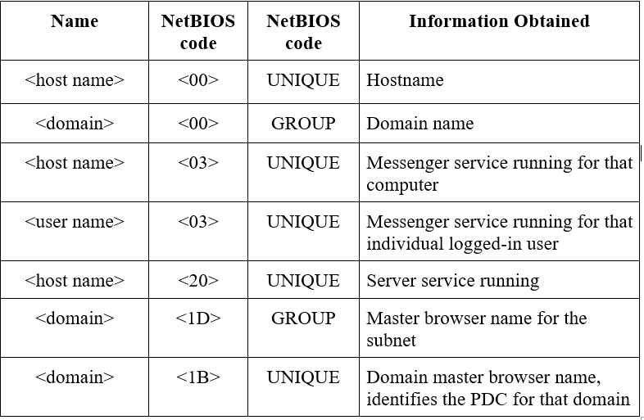
NETBIOS enumeration

Slide 7
Nbstat utility in windows displays NETBIOS over TCP?IP protocol statistics, NETBIOS name tables for both local and remote computers and NETBIOS name cache
Command nbtstat

Slide 8
NETBIOS enumeration tools
Hyena- GUI product to manage & secure Microsoft operating system. Shares & user logon names for windows servers and domain controllers.
Netscan Tools pro
Superscan
Nbtscan

Slide 9
Enumerating UserAccounts
PsExec-execute processes remotely
PsFile- shows files remotely
Pskill-kill processes by name or process ID
Psinfo-list information about a system
PsPasswd-change account passwords.

Slide 10
Simple Network Management Protocol Enumeration
It’s a process of enumerating user accounts and devices on a target system using SNMP.
Consists of a manager and agents. Agents are embedded on every network device and manager is installed is installed in a different computer.

Slide 11
SNMP holds 2 passwords that access and configure SNMP agent from management station.

Slide 12
Management Information Base
It’s a virtual database containing formal description of all network objects that can be managed using SNMP.
Addressed through Object Identifiers.
2 types of managed objects
Scalar objects
Tabular objects

Slide 13
SNMP Enumeration tools
OpUTILS
Engineer’s Toolset
Netscan Tools Pro
SNMP informant

Slide 14
LDAP Enumeration
Lightweight Directory Access Protocol is an internet protocol for accessing distributed directory services.
Directory services may provide organized set of records in a hierarchical logical structure
Client starts an LDAP session by connecting to a Directory System Agent on TCP port 389 and sends a request to DSA.
Info is transmitted between server and client using Basic Encoding Rules.
Attack queries LDAP to gain info ie usernames

Slide 15
LDAP Enumeration tools
Softerra LDAP Administrator
LDAP Admin Tools
Ldap search
Active Directory Explorer

Slide 16
NTP Enumeration
Network Time Protocol is designed to synchronize clocks of networked computers.
Uses UDP 123 as a primary means of communication.
Attacker queries NTP server to garther info ie- List of hosts connected to NTP server.
– Client IP addresse

Slide 17
NTP Enumeration commands
Nptrace- Traces a chain of NTP severs back to primary source.
Ntpdc-Monitor operations of the NTP daemon.
Ntpq-Monitor NTP daemon ntpd operations and determine performance

Slide 18
NTP Enumeration tools
PRTG Network Monitor-shows response time of the server and time difference in comparison to local system time.
Nmap
Wireshark

Slide 19
SMTP Enumeration
Provides 3 built-in commands
VRFY: validates users
EXPN- Tells the actual delivery address of aliases and mailing lists
RCPT TO- Defines recipients of messages

Slide 20
SMTP Enumeration tools
NetScan Tools Pro
Smtp-user-enum

Slide 21
DNS Enumeration using Zone Transfer
Process of locating DNS Serer and records of a target network.
An Attacker can gather valuable information such as DNS server name, host names.
An attacker tries to retrieve a copy of the entire zone file for a domain from DNS Server.

Slide 22
Other Enumeration Techniques
Ipsec Enumeration- It uses Encapsulation Security Payload, Authentication Header and Internet Key Exchange to secure communication between virtual private network end points.
Most Ipsec based VPNs use Internet Security Association and Key Management Protocol to establish, negotiate, modify and delete Security Associations and cryptographic keys.

Slide 23
Scan ISAKMP at UDP port 500 can indicate prescence of a VPN gateway.
Attackers can probe futher by tools uch as ike-scan to enumerate and sensitize information ie encryption

Slide 24
VOIP enumeration
Uses Session Initiation Protocol to enable voice calls and video calls over an IP network.
SIP services generally us UDP?TCP 2001,5050,5061
VOIP enumeration provide sensitive information such as VOIP gateway/servers, IP-PBX systems.
Attacks- DOS, Session Hijacking

Slide 25
RPC Enumeration
Allows Client and Server to communicate in distributed client/server programs.
Attackers identify any vulnerable services on ports.

Slide 26
Unix/Linux User Enumeration
Rusers-displays users logged on a remote machine
Rwho-Displays lists of users logged into a host on a local network.
Finger-Information about system users

Slide 27
Enumeration Countermeasures
SNMP
Remove SNMP agent or turn off the service
Upgrade to SNMP3, encrypts passwords
Null session pipes, null session shares are restricted.
DNS
Disable DNS zone transfers to untrusted hosts.
Uses standard network admin contacts.
Make sure private hosts and IP address are not published in DNS zone file.

Slide 28
SMB
Disable SMB protocol on Web and DNS Servers.
Disable port 139 and 445.
Restrict Anonymous access in the Windows Registry
LDAP
Set a different username from email address tat enables account lockout.
Use SSL, encryption.

Slide 29
Enumeration Pretesting
Identify valid users accounts .
Used in combination with data collected in reconnaissance phase

Slide 30


Thank you!
Any Questions?

